Slide 1
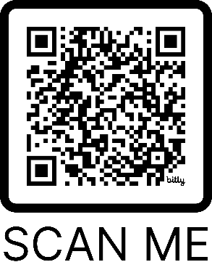
Supports are free and
delivered in partnership between HSE & community partners.
Integrated Care Pathway for Alcohol
Dublin North City & County (DNCC)
Criteria:
Through Making Every Contact Count / brief intervention, you are aware a patient/client is
experiencing some level of harm from their alcohol use,
interested in exploring reducing or abstaining,
over 18,
living in DNCC.
Key Working & Case Management.
Medical care for dependence
Individualised treatment and care paths with appropriate onward referrals based on level/severity of problem alcohol use.
SAOR Extended Brief Intervention in Primary Care
For adults experiencing harm from alcohol use but not at dependence stage.
Alcohol screening and comprehensive assessment.
Refer to Integrated Alcohol Service DNCC (IAS)
To refer
download Referral Form from www.bit.ly/AlcoholSupportDNCC
Email referral form to iasdublinreferrals@hse.ie
Or simply call IAS on 01 856 6406 for self-referrals/info!

